Slide 1
CSC 455: Database Processing for Large-Scale Analytics
Lecture 6
Alexander Rasin
College of CDM, DePaul University
October 29th, 2013

Slide 2
Tonight
Nested queries
Views
Regular expressions
Tweets
Python
  NumPy
  Pandas
Triggers

Slide 3
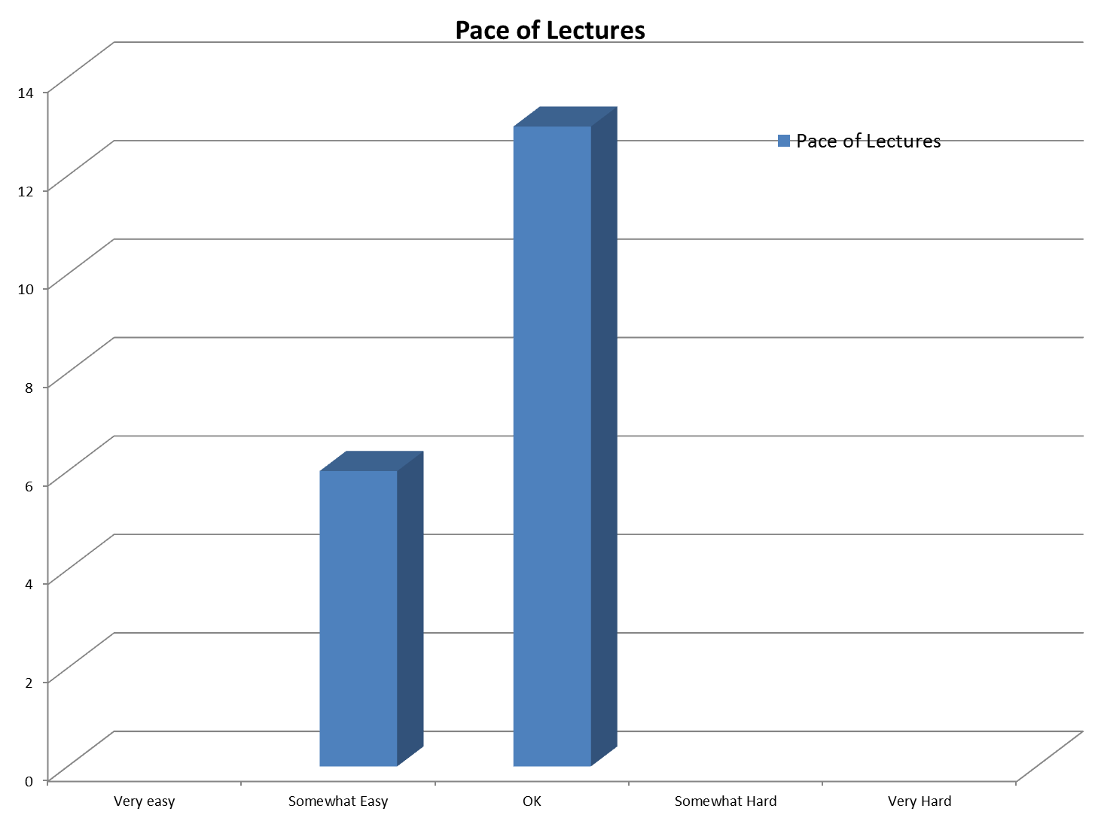


Slide 4
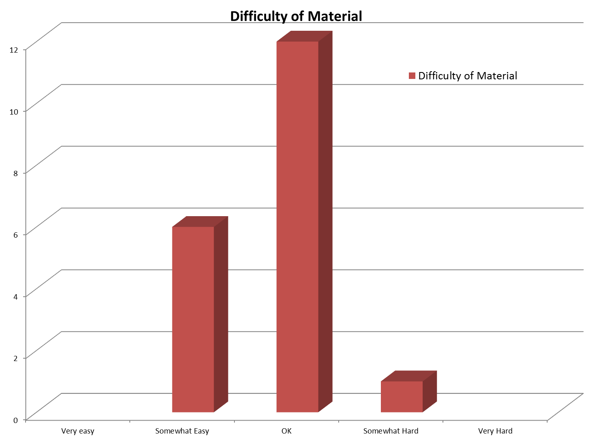

Slide 5
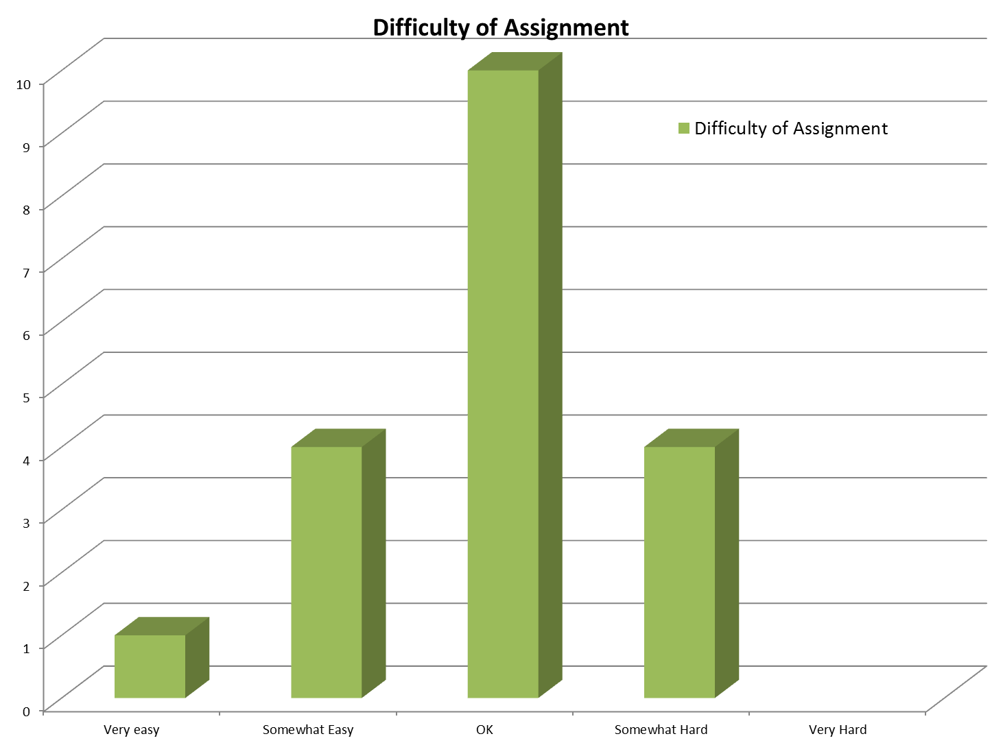

Slide 6
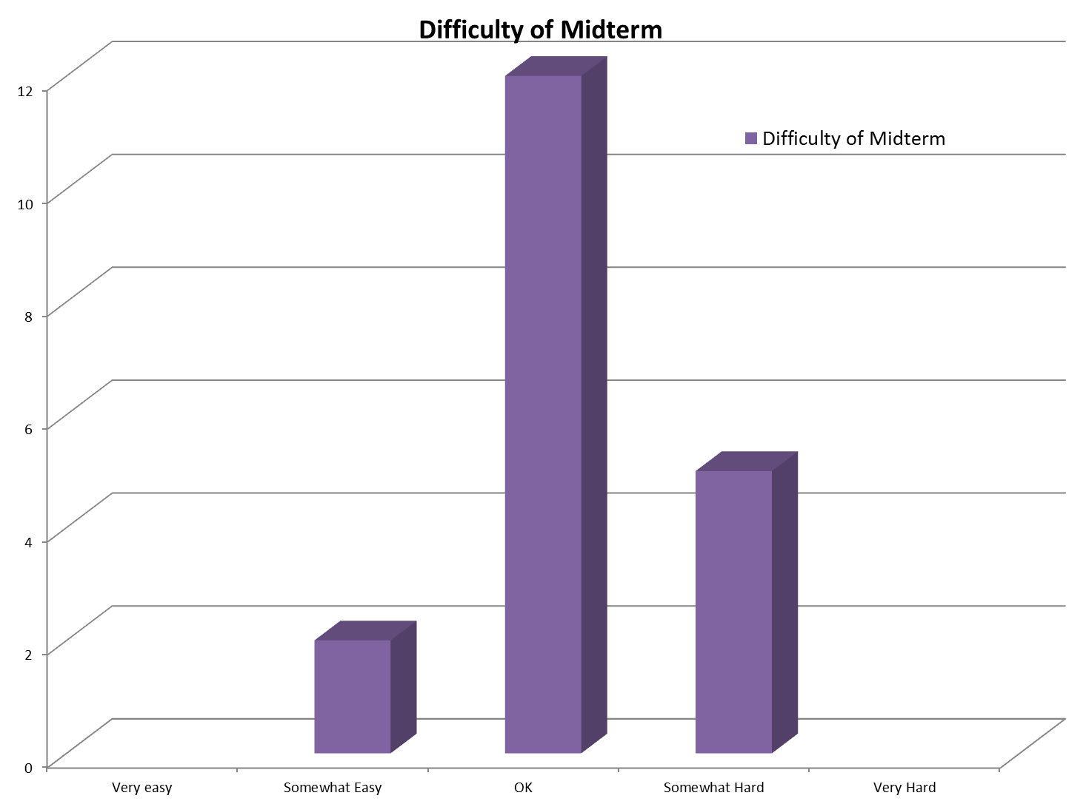

Slide 7
Midterm
Well done!
Average:
  89
Median
  92

Slide 8
Specific Comments
Keep material challenging
Too much database intro
  CSC455 is a CSC451 substitute
More reading material
More python
Review
  Python dictionaries
  Functional dependencies

Slide 9
Nested Queries Syntax
Must always appear within parentheses
Can only appear on the right-hand side of a comparison
SELECT can only specify a single attribute unless using IN or EXISTS
Attribute names refer to tables in FROM clause of the nested query (unless qualified)
Cannot use ORDER BY

Slide 10
Returning a Table
Check whether subquery result is empty:
  EXISTS (query) will return true if result of nested query is not empty
  NOT EXISTS (query) will do the opposite
Check contents of table:
  tuple IN (query) returns true if tuple appears in result table

Slide 11
Correlated Nested Queries
Nested query may refer to attributes of the table(s) given in the outer query
  These must be qualified with table name(s)
  Nested query will be evaluated repeatedly, once for each tuple in the table in the outer query
  Have to rename table in outer query if it is also referenced in nested query

Slide 12
Existence
Tests that a set is nonempty
SELECT LastName, FirstName, sid
FROM student
WHERE EXISTS (SELECT *
FROM enrolled
WHERE sid = studentID);
SELECT LastName, FirstName, sid
FROM student
WHERE NOT EXISTS (SELECT *
FROM enrolled
WHERE sid = studentID);

Slide 13
Unique Existence
Tests that a set contains one element
SELECT LastName, FirstName, sid
FROM student
WHERE UNIQUE (SELECT *
FROM enrolled
WHERE sid = studentID);
Not supported by Oracle, Access or SQLServer
Notes:
SELECT LastName, FirstName, sid
FROM student
WHERE (SELECT COUNT(*)
FROM enrolled
WHERE sid = studentID) = 1;

Slide 14
Correlated Nested Queries
List students who have taken IT, but no CSC courses.
List student groups that have both graduate and undergraduate members.
List courses in which no student from Chicago ever enrolled.

Slide 15
Nested Aggregate Functions
SELECT LastName, FirstName, SID
FROM student
WHERE (SELECT count(*)
FROM enrolled
WHERE SID = StudentID) >= 2;
SELECT LastName, FirstName, SID,
(SELECT count(*)
FROM enrolled
WHERE SID = StudentID) AS EnrCrs
FROM student;

Slide 16
Nested Aggregate Functions Examples
List students enrolled in at least two courses in 2006.
List student groups with less than 3 members.
List classes with the largest enrollment.
Notes:
SELECT CID, COUNT(*)
FROM Course, Enrolled
WHERE CID = CourseID
HAVING COUNT(*) >= ALL (SELECT COUNT(*) FROM Enrolled GROUP BY CourseID)
GROUP BY CID

Slide 17
Views
Results of a query can be stored in a view:
CREATE VIEW VIEW_NAME
AS query;
Views can be used like tables in queries
Views are reconstructed each time they are used, though they can also be stored in memory (and automatically updated)

Slide 18
Examples
(StudentID, Name, Age, Transfer, Standing)
CREATE VIEW JuniorStudents
AS SELECT * FROM Student
WHERE standing = ‘Junior’;
CREATE VIEW TransferStudents
AS SELECT * FROM Student
WHERE Transfer = ‘yes’;

Slide 19
Example
(StudentID, Name, Age, Transfer, Standing)
New data in the table
  INSERT INTO Student VALUES (‘8’, ‘Lynn T.’, 20, ‘no’, ‘Junior’);
  INSERT INTO Student VALUES (‘9’, ‘James B.’, 25, ‘yes’, ‘Senior’);
  INSERT INTO Student VALUES (‘10’, ‘Lily P.’, 20, ‘yes’, ‘Junior’);

Slide 20
Updating Dynamic Views
If a view is updatable, all updates are allowed by default
  WITH CHECK OPTION forbids all updates that do not belong in the view
  WITH READ ONLY forbids all updates

Slide 21
Example
(StudentID, Name, Age, Transfer, Standing)
Insert data in the views?
  INSERT INTO JuniorStudents
  VALUES('11', 'Mark M.', 25, 'no', 'Junior');
  INSERT INTO TransferStudents
  VALUES('12', 'Alice A.', 23, 'yes', 'Senior');
  INSERT INTO TransferStudents
  VALUES('13', 'Ann B.', 21, 'no', 'Junior');

Slide 22
Example
(StudentID, Name, Age, Transfer, Standing)
CREATE VIEW LimitedStudentView
AS SELECT StudentID, Name, Transfer, Standing FROM Student;
Inserting data into the Student table
  Shows all data (except age)

Slide 23
Example
(StudentID, Name, Age, Transfer, Standing)
LimitedStudentView:
(StudentID, Name, Transfer, Standing)
New data insert into the LimitedStudentView
  INSERT INTO LimitedStudentView
  VALUES ('15', 'Lucky S.', 'yes', 'Freshman');
  What would you do?

Slide 24
Example
(StudentID, Name, Age, Transfer, Standing)
CREATE VIEW AgeRangeReport
AS SELECT Standing, MIN(Age) AS MinAge,
MAX(Age) AS MaxAge, FROM Student
GROUP BY Standing;
Inserting data into the Student table
  Propagated into the view if relevant

Slide 25
Example
(StudentID, Name, Age, Transfer, Standing)
VIEW AgeRangeReport(Standing,MinAge,MaxAge)
Update the original table
  INSERT INTO Student VALUES('16', 'Ellis F.', 58, 'yes', 'Junior');
Insert data into this view
  INSERT INTO AgeRangeReport
  VALUES('Pre-College', 15, 20);

Slide 26
LIKE Escape
SELECT *
FROM Student
WHERE LastName LIKE '%\%%' ESCAPE '\';
SELECT *
FROM Student
WHERE FirstName LIKE '%Q___Q_%' ESCAPE 'Q';
Notes:
INSERT INTO Student
values ( 'Bren%nigan', 'Ma_rc_us', 90422, 987654322, 'UGRD', 'COMP-GPH', 'Evanston', 2001 );

Slide 27

Regular Expressions in Oracle

Slide 28
Regular Expressions
Allow you to search for complex patterns
More flexible than LIKE
Example (f|ht)tps?:
  Matches http:, https:, ftp: or ftps:

Slide 29
Regular Expression Examples
SELECT * FROM Strings
WHERE REGEXP_LIKE(String, '(f|ht)tps?:');
SELECT * FROM Strings
WHERE REGEXP_LIKE(String, '(CSC|GPH)');
SELECT * FROM Strings
WHERE REGEXP_LIKE(String, '(C|S){3}');
SELECT * FROM Strings
WHERE REGEXP_LIKE(String, 'CSC.*edu');

Slide 30
Regular Expressions
. — Matches any character
  a.b matches abb, acb and adb , but not acc
\d — Matches a digit character
\w — Word character (alphanumeric or underscore)
\s — A whitespace character (space or tab)
^$ — Matches beginning/end of string
? — Preceding pattern is optional
* — Match any number of pattern repetitions
+ — Match one or more pattern repetetions
{n}— Match the preceding pattern n times

Slide 31
Regular Expression Examples
SELECT * FROM Strings
WHERE REGEXP_LIKE(String, '^\w{2}\d{3}');
SELECT * FROM Strings
WHERE REGEXP_LIKE(String, '^(f|ht)tps?:.{12}.com//?$');
SELECT * FROM Strings
WHERE REGEXP_LIKE(String, '^[^a]+$');
SELECT * FROM Strings
WHERE REGEXP_LIKE(String, '^.+(f|ht)tps?:');

Slide 32
Regular Expression Example
CREATE TABLE contacts
( l_name VARCHAR2(30),
p_number VARCHAR2(30) ,
CONSTRAINT p_number_format
CHECK
( REGEXP_LIKE ( p_number, '^\(\d{3}\) \d{3}-\d{4}$' ) ) );
INSERT INTO contacts (p_number) VALUES( '(650) 555-5555' ); INSERT INTO contacts (p_number) VALUES( '(215) 555-3427' );
INSERT INTO contacts (p_number) VALUES( '650 555-5555' );
INSERT INTO contacts (p_number) VALUES( '650 555 5555' ); INSERT INTO contacts (p_number) VALUES( '(650)555-5555' );

Slide 33

A Break!

Slide 34
Twitter
Social networking/microblogging service
Text messages limited to 140 characters
  “SMS of the internet”
500M registered users
340M tweets per day
1.6 Billion search queries per day

Slide 35
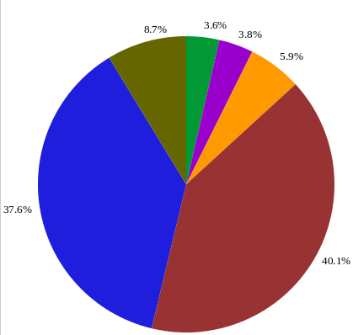
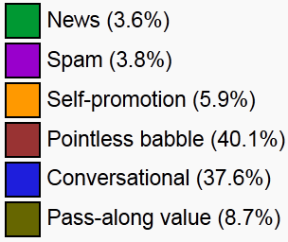
Contents

Slide 36
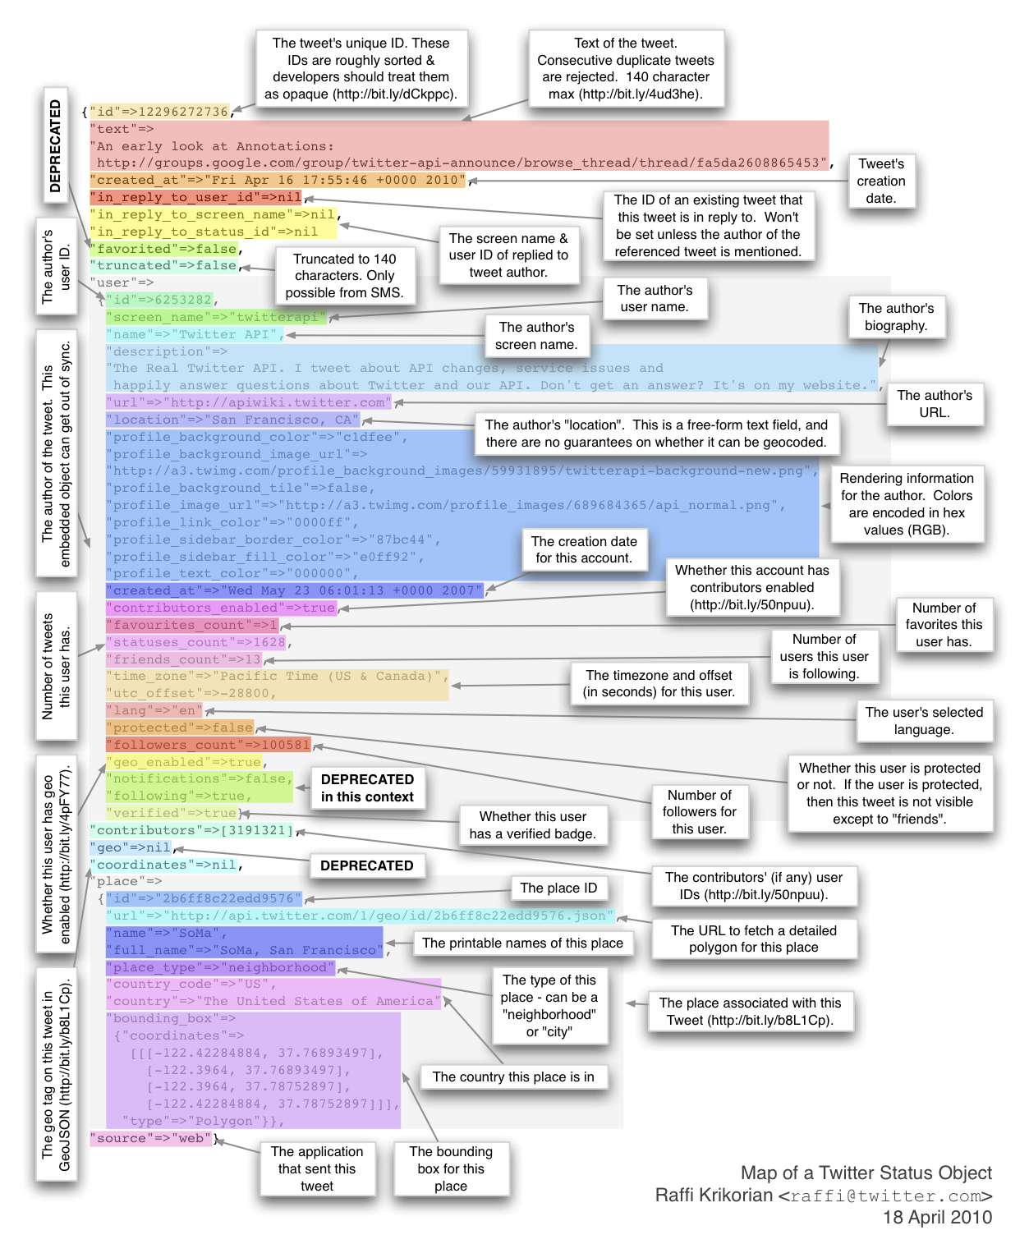
Notes:
http://i.i.cbsi.com/cnwk.1d/i/tim//2010/04/20/30146338-map-of-a-tweet.png
http://rasinsrv07.cstcis.cti.depaul.edu/CSC455/tweet_data.txt

Slide 37
ndarray
def genRandomMatrix(x, y):
matrix = []
for i in range(y):
randomVector = map(lambda x:random.random(), [0]*x)
matrix.append(randomVector)
return matrix

Slide 38
ndarray
m1 = genRandomMatrix(3,3)
array1 = numpy.array(m1)
array1.ndim
array1.shape
array1.dtype
numpy.identity(4)
numpy.zeros((4,5))

Slide 39
ndarray
array1 + array1
array1 * 100
array1 * array1
array1 ** 10
invert = 1/array1
invert * array1

Slide 40
ndarray
array1[0]
array1[1:3]
array1[2][0]
array1[2, 0]
array1[1:, :1] # :2, :3

Slide 41
ndarray
names = numpy.array(['Ruben', 'Dyan', 'Jaye', 'Caprice', 'Golda', 'Jovita', 'Bryon', 'Dyan', 'Tamika', 'Dyan'])
match = (names == 'Dyan')
rmatrix = numpy.random.randn(10, 5)
rmatrix[match]

Slide 42
ndarray
rmatrix > 0
rmatrix[rmatrix > 0]
rmatrix[rmatrix < 0.24]
numpy.ceil(rmatrix)
numpy.floor(rmatrix)
rmatrix2 = numpy.random.randn(10, 5)
numpy.greater(rmatrix, rmatrix2)

Slide 43
NumPy
numpy.where(rmatrix2 > 0, 'Positive', 'Negative')
rmatrix.mean()
rmatrix.max()
rmatrix.min()
rmatrix.size
rmatrix.sum()/rmatrix.size
rmatrix.sort()
rmatrix.tolist()

Slide 44
NumPy
myarray = numpy.arange(10,100)
os.getcwd()
numpy.save('my_array', myarray)
numpy.load('my_array.npy')
numpy.loadtxt('RandomData.txt', delimiter = ',')
numpy.savetxt('my_array2', myarray)
Notes:
3,4,2,3,4,5,6
1,2,3,4,5,6,8
11,23,123,123,0,0,0

Slide 45
Pandas Data Structures
series1 = pandas.Series([1, 17, 2, -5, 4])
numpy.array(series1)
series1.index
series2 = pandas.Series([1, 17, 2, -5, 4], index=['x', 'y', 'z', 'p', 'q'])
series2['y']
series2[['z', 'q']]

Slide 46
Pandas Data Structures
series1 > 2
series1[series1 > 2]
series2 * 2
'z' in series2
dict1 = {'Ohio':35000, 'Texas' : 71000, 'Oregon': 16000, 'Utah':5000}
States = pandas.Series(dict1)
States[['Ohio', 'Maine', 'Utah']]

Slide 47
Pandas Data Structures
data = {'states' : ['Ohio', 'Ohio', 'Ohio', 'Nevada', 'Nevada'],
'year':[2000, 2001, 2002, 2001, 2002],
'pop':[1.5, 1.7, 3.6, 2.4, 2.9]}
frame = pandas.DataFrame(data)
pandas.DataFrame(data, columns = ['year', 'state', 'pop'])
frame2 = pandas.DataFrame(data, index=['1st', '2nd', '3rd', '4th', '5th'])
frame2['year']
frame2.states

Slide 48
Pandas Data Structures
frame2.reindex(['5th', '4th', '3rd', '2nd', '1st', '0th'])
frame2.reindex(['5th', '4th', '3rd', '2nd', '1st', '0th'], fill_value = 0)
series3 = pandas.Series(['red', 'green', 'blue'], index=[0, 4, 7])
series3.reindex(range(12), method='ffill')

Slide 49
Topics discussed earlier
basic constraints
  entity integrity (not null)
  referential integrity (foreign key)
  key constraint (primary key)
  candidate key constraint (uniqueness)
CHECK constraints
  attribute-level
  tuple-level

Slide 50
Triggers
Triggers allow general responses to changes in the database state:
  Enforcement of business rules
  Notification of events
  Maintenance of derived information
  Maintenance of replicated data
  Implementation of cross-table constraints

Slide 51
Event-Condition-Action Model
An event causes the trigger to fire
  Before or after an insertion, deletion, or update
A condition is tested to see whether or not the trigger will respond (optional…)
  May depend on original state or modified state
An action may be executed in response
  May be sequence of SQL statements or some stored procedure

Slide 52
Triggers
CREATE OR REPLACE TRIGGER started
BEFORE UPDATE OF started ON student
FOR EACH ROW
WHEN (new.started < old.started)
BEGIN
:new.started := :old.started;
DBMS_OUTPUT.PUT_LINE('Rejected change of started');
END;
/
SET SERVEROUTPUT ON;
UPDATE student
SET Started = 2001;
SELECT * FROM student;

Slide 53
Triggers
Create trigger
CREATE OR REPLACE TRIGGER started
BEFORE UPDATE OF started ON student
FOR EACH ROW
WHEN (new.started < old.started)
BEGIN
:new.started := :old.started;
DBMS_OUTPUT.PUT_LINE('Rejected change of started');
END;
/
triggering event
attribute/table
row trigger
trigger restriction
old: row before update
new: row after update
trigger action
(in PL/SQL)

Slide 54
Triggering Events
CREATE OR REPLACE TRIGGER started
BEFORE UPDATE OF started ON student
FOR EACH ROW
WHEN (new.started < old.started)
BEGIN
:new.started := :old.started;
DBMS_OUTPUT.PUT_LINE('Rejected change of started');
END;
/
When do we trigger:
before
after
instead of
(only for views)
What is doing the triggering:
insert, update, delete
system events

Slide 55
row/statement trigger
WHEN only
for row-level
triggers
CREATE OR REPLACE TRIGGER started
BEFORE UPDATE OF started ON student
FOR EACH ROW
WHEN (new.started < old.started)
BEGIN
:new.started := :old.started;
DBMS_OUTPUT.PUT_LINE('Rejected change of started');
END;
/
:new/:old only
for row-level
triggers
vs
CREATE OR REPLACE TRIGGER started
AFTER UPDATE ON student
BEGIN
DBMS_OUTPUT.PUT_LINE(Student Table updated');
END;
/

Slide 56
Restriction (WHEN)
CREATE OR REPLACE TRIGGER started
BEFORE UPDATE OF started ON student
FOR EACH ROW
WHEN (new.started < old.started)
BEGIN
:new.started := :old.started;
DBMS_OUTPUT.PUT_LINE('Rejected change of started');
END;
/
old
(before change)
new
(after change)

Slide 57
Trigger Action
BEGIN
pl/sql block
END;
/
:old, :new
variables
dbms_output
CREATE OR REPLACE TRIGGER started
BEFORE UPDATE OF started ON student
FOR EACH ROW
WHEN (new.started < old.started)
BEGIN
:new.started := :old.started;
DBMS_OUTPUT.PUT_LINE('Rejected change of started');
END;
/

Slide 58
Example: Logging
CREATE OR REPLACE TRIGGER studentlog
AFTER INSERT OR UPDATE OR DELETE ON student
BEGIN
DBMS_OUTPUT.PUT_LINE('Insert/Delete/Update on Student Table');
END;
/
CREATE OR REPLACE TRIGGER started
AFTER INSERT OR UPDATE OR DELETE ON student
BEGIN
IF UPDATING THEN
DBMS_OUTPUT.PUT_LINE('Update on Student');
ELSIF INSERTING THEN
DBMS_OUTPUT.PUT_LINE('Insert on Student');
ELSIF DELETING THEN
DBMS_OUTPUT.PUT_LINE('Delete on Student');
END IF;
END;
/

Slide 59
Unique ID: Sequences in Oracle
--- create a new sequence for student table
CREATE SEQUENCE SEQ_STUDENT_ID
INCREMENT BY 1
START WITH 1;
--- example application
INSERT INTO student(SID, LastName,FirstName)
VALUES(seq_student_id.nextval, 'Pendleton', 'Gabriela');
--- drop sequence
DROP SEQUENCE seq_student_id;

Slide 60
Using sequence with trigger
--- create a new sequence for student table
CREATE SEQUENCE SEQ_STUDENT_ID
INCREMENT BY 1
START WITH 1;
--- create trigger to insert new ID automatically
CREATE OR REPLACE TRIGGER student_id_trigger
BEFORE INSERT ON student
FOR EACH ROW
BEGIN
SELECT seq_student_id.nextval
INTO :new.SID
FROM dual;
END;
/
Notes:
SHOW ERRORS

Slide 61
Example: Logging into table
CREATE OR REPLACE TRIGGER studentlog
AFTER INSERT ON student
FOR EACH ROW
BEGIN
DBMS_OUTPUT.PUT_LINE('Insert on Student Table');
insert into elog
values(seq_student_id.nextval, :new.SID, 'I', systimestamp);
END;
/
CREATE TABLE elog(
eid NUMBER,
esid NUMBER(5),
etype CHAR,
etime DATE,
PRIMARY KEY(eid)
);

Slide 62
Auto-generated Columns
DROP TABLE TableX;
CREATE TABLE TableX
( UniqueID RAW(16) DEFAULT SYS_GUID() PRIMARY KEY,
Value Varchar2(50)
)
INSERT INTO TableX (Value) VALUES ('Value1');
INSERT INTO TableX (Value) VALUES ('Value2');
INSERT INTO TableX (Value) VALUES ('Value3');

Slide 63
Auto-generated Columns
DROP TABLE TableX;
CREATE TABLE TableX
( UniqueID INTEGER PRIMARY KEY,
Value Varchar2(50)
)
INSERT INTO TableX VALUES (MySequence.nextval, 'Value1');
INSERT INTO TableX VALUES (MySequence.nextval, 'Value2');
INSERT INTO TableX VALUES (MySequence.nextval, 'Value3');
CREATE SEQUENCE MySequence
MINVALUE 100 MAXVALUE 1000000000
START WITH 100 INCREMENT BY 5
CACHE 20;

Slide 64
Auto-generated Columns
CREATE TRIGGER MyTrigger
BEFORE INSERT ON TableX
FOR EACH ROW
WHEN (new.id IS NULL)
BEGIN
SELECT MySequence.nextval
INTO :new.id FROM dual;
END;

Slide 65
Next Time:
Python
  Finish Ch5, Ch6
Loading/cleaning/merging data
Read Chapter 4, Chapter 5
(Assignment 4 posted tonight)

